Slide 1
Abstraction & Encapsulation

Slide 2
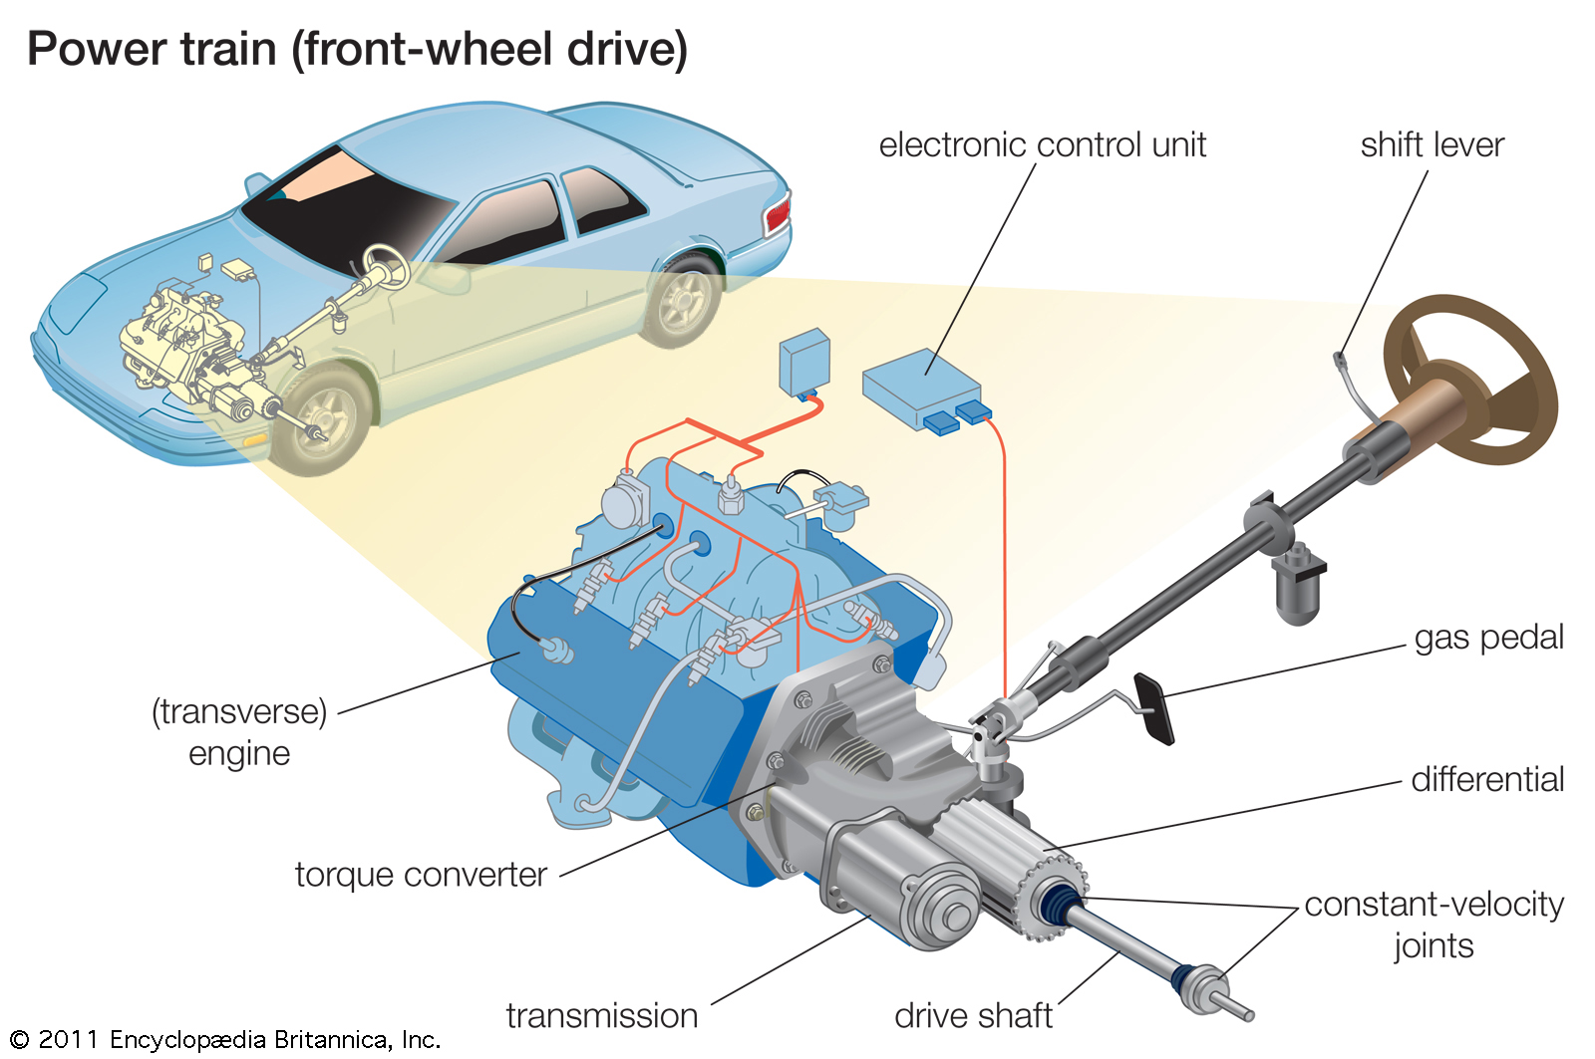

Abstraction
Data Abstraction => process of identifying only the required characteristics of an object ignoring the irrelevant details.

Slide 3
Abstraction in Java
Data Abstraction is the property by which only the essential details are displayed to the user. The trivial or the non-essentials units are not displayed to the user. Ex: A car is viewed as a car rather than its individual components.
In java, abstraction is achieved by interfaces and abstract classes.
We can achieve 100% abstraction using interfaces.

Slide 4


Abstract class & Interface
No!
Yes!

Slide 5
Why abstraction?
It reduces the complexity of viewing the things.
Avoids code duplication and increases reusability.
Helps to increase security of an application or program as only important details are provided to the user.

Slide 6

Encapsulation

Slide 7
Encapsulation in Java
wrapping up of data under a single unit.
As in encapsulation, the data in a class is hidden from other classes using the data hiding concept which is achieved by making the members or methods of class as private and the class is exposed to the end user or the world.
Encapsulation can be achieved by:
Declaring all the variables in the class as private and writing public methods in the class to set and get the values of variables.

Slide 8
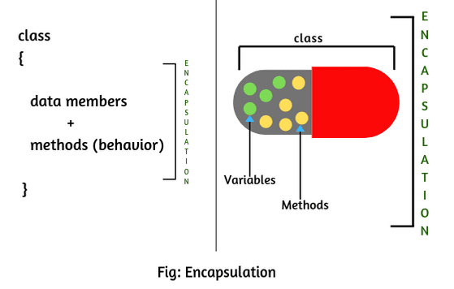

Slide 9
Why Encapsulation?
Data Hiding
Increased Flexibility
Reusability
Testing code is easy

Slide 10
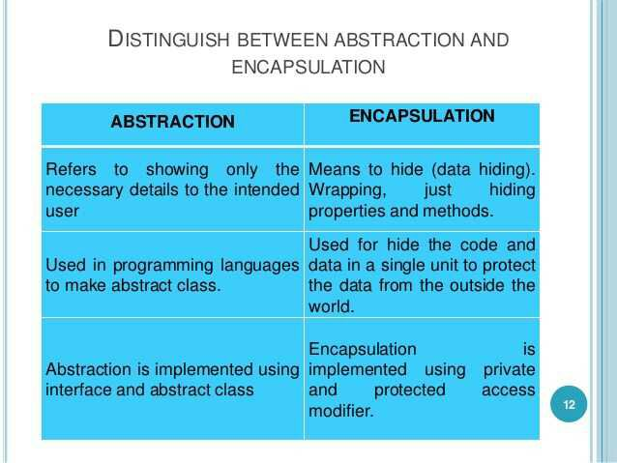
Abstraction vs Encapsulation

Slide 11


